Slide 1
Overview of the HIV continuum of care in Europe and Central Asia
Teymur Noori
European Centre for Disease Prevention and Control
Sweden

Slide 2
Overview of the HIV continuum of care in Europe and Central Asia
Teymur Noori, ECDC
22nd International AIDS Conference, Amsterdam 2018
ECDC/EACS satellite: Getting to 90: Addressing inequalities in the HIV continuum of care in Europe and Central Asia
Monday 23 July 2018 – 12:30-14:30

Slide 3
Disclosure
Employed by the European Centre for Disease Prevention and Control
No potential conflict of interests

Slide 4
Outline
Show progress toward achieving the global 90-90-90 treatment targets in Europe and Central Asia
Highlight the inequalities along the continuum in our region by focusing on the variation:
between countries
between sub-regions
within sub-regions

Slide 5
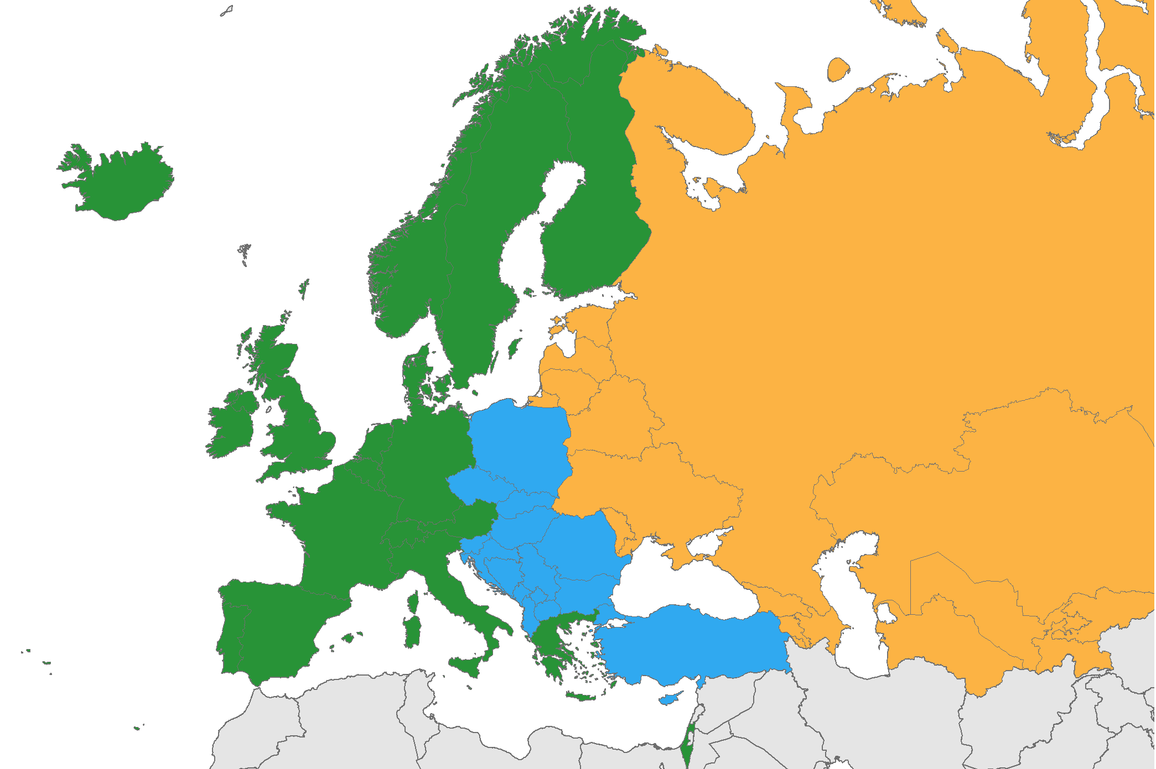
>160 000 persons were diagnosed with HIV in the WHO European Region in 2016
East
80%
≈ 128,000 cases
West
16%
≈ 26,000 cases
Centre
4%
≈ 5,800 cases
Source: ECDC/WHO (2017). HIV/AIDS Surveillance in Europe 2017– 2016 data

Slide 6
Data availability on the continuum of care 2014 (n=40); 2016 (n=44); 2018 (n=43)
Promoting collaboration between clinical, public health and community bodies
Source: ECDC. Dublin Declaration monitoring 2018; validated unpublished data.

Slide 7
Fast Track Targets by 2020
Target 1
Target 2
Target 3
Overall target
73%
of all people living with HIV
VIRALLY SUPPRESSED
=
living with HIV
DIAGNOSED
diagnosed with HIV
ON ART
on ART
VIRALLY SUPPRESSED

Slide 8
Fast Track Targets by 2020
Target 1
Target 2
Target 3
Overall target
73%
of all people living with HIV
VIRALLY SUPPRESSED
=
living with HIV
DIAGNOSED
diagnosed with HIV
ON ART
on ART
VIRALLY SUPPRESSED

Slide 9
Progress toward achieving the 1st 90: 90% of all PLHIV who know their status (n=39)
Target reached
Above regional average
Below regional average
Global target 90%
Regional average 80%
Source: ECDC. Dublin Declaration monitoring 2018; validated unpublished data.
Latest available data reported, ranging from 2014-2017.

Slide 10
Progress toward achieving the 1st 90: Sub-regional variation: West, Centre, East
Source: ECDC. Dublin Declaration monitoring 2018; validated unpublished data.

Slide 11
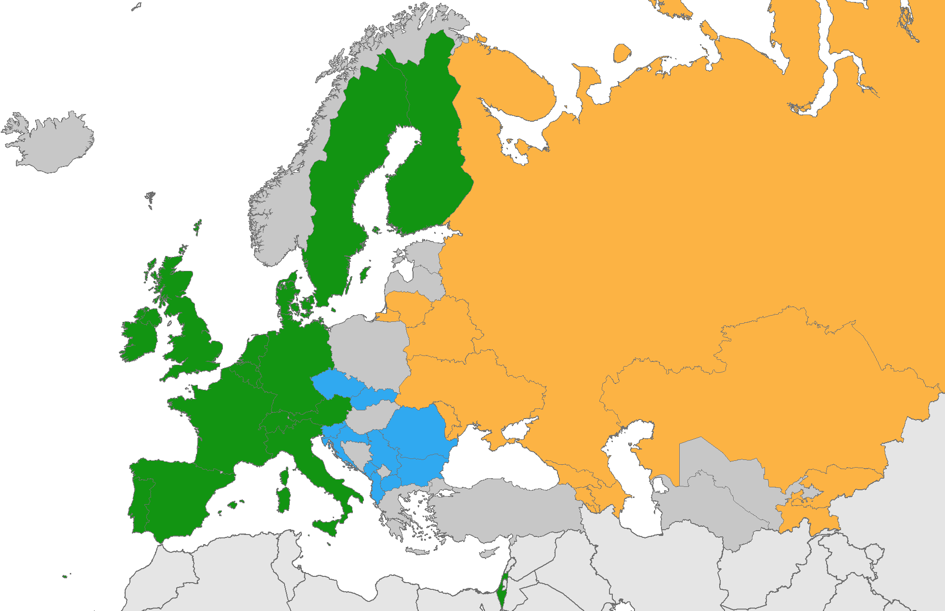
Significant within sub-region variation in achieving the 1st 90 (diagnoses)
48-94%
74-93%
46-90%
Source: ECDC. Dublin Declaration monitoring 2018; validated unpublished data.

Slide 12
Fast Track Targets by 2020
Target 1
Target 2
Target 3
Overall target
73%
of all people living with HIV
VIRALLY SUPPRESSED
=
living with HIV
DIAGNOSED
diagnosed with HIV
ON ART
on ART
VIRALLY SUPPRESSED

Slide 13
Progress toward achieving the 2nd 90: 90% of those diagnosed on ART (n=40)
Target reached
Above regional average
Below regional average
Global target 90%
Regional average 64%
Source: ECDC. Dublin Declaration monitoring 2018; validated unpublished data.
Latest available data reported, ranging from 2014-2017.

Slide 14
Progress toward achieving the 2nd 90: Significant sub-regional variation: West, Centre, East
Source: ECDC. Dublin Declaration monitoring 2018; validated unpublished data.

Slide 15
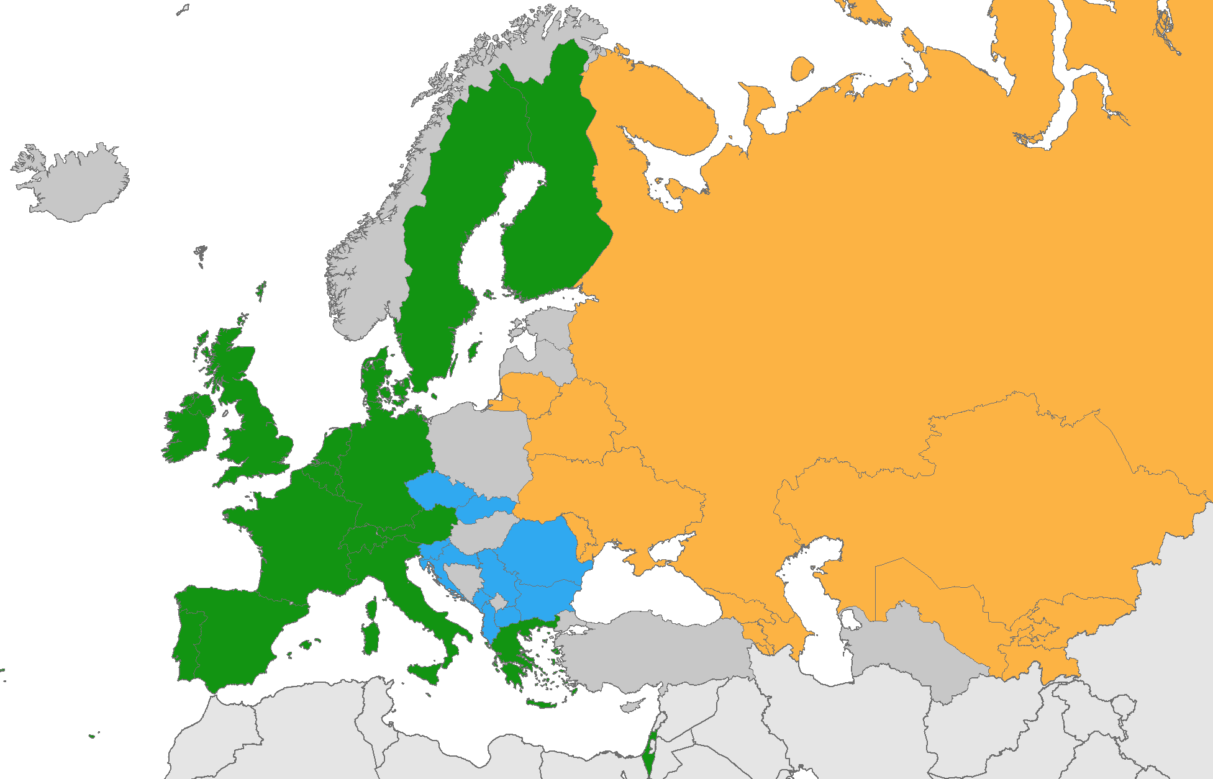
Significant within sub-region variation in achieving the 2nd 90 (ART)
30-95%
58-100%
50-85%
Source: ECDC. Dublin Declaration monitoring 2018; validated unpublished data.

Slide 16
Policies on ART initiation in European countries 2014 (n=49)
2015
Source: ECDC. Dublin Declaration monitoring 2018; validated unpublished data.

Slide 17
Policies on ART initiation in European countries 2014 (n=49)
2015
Source: ECDC. Dublin Declaration monitoring 2018; validated unpublished data.

Slide 18
Policies on ART initiation in European countries 2014 (n=49), 2016 (n=47)
2015
Source: ECDC. Dublin Declaration monitoring 2018; validated unpublished data.

Slide 19
Policies on ART initiation in European countries 2014 (n=49), 2016 (n=47), 2018 (n=52)
2015
Source: ECDC. Dublin Declaration monitoring 2018; validated unpublished data.

Slide 20
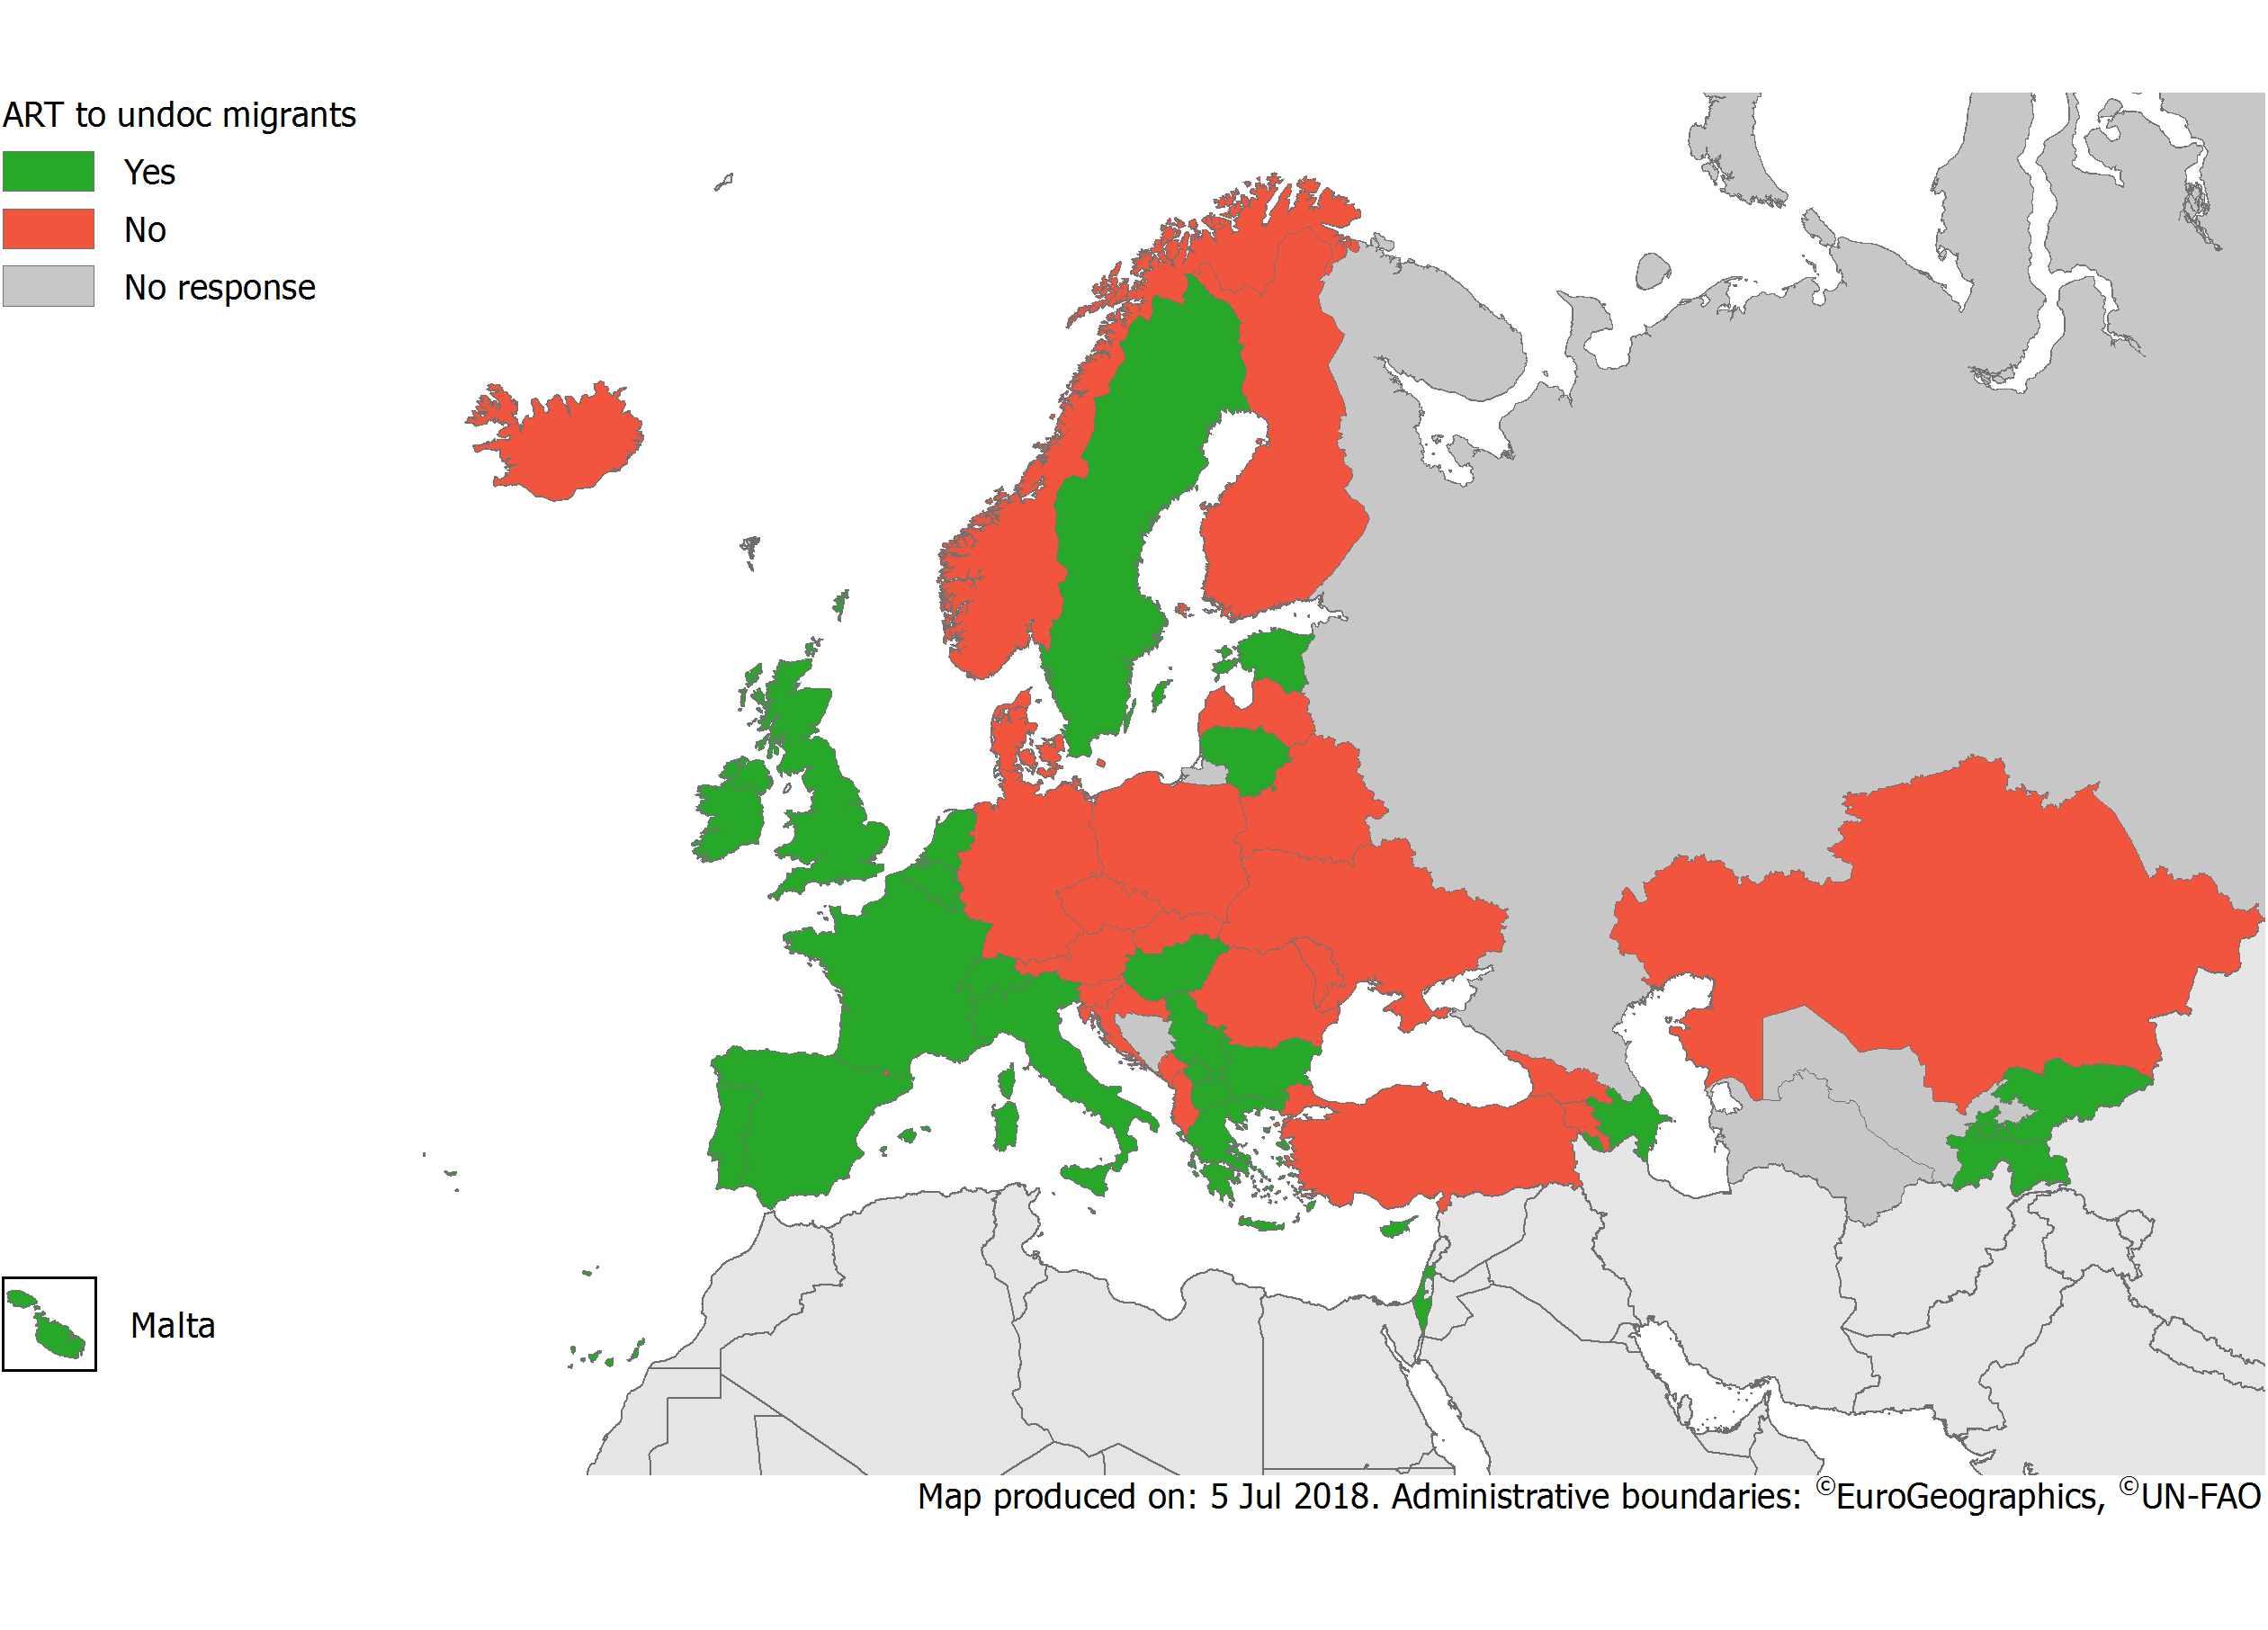
Availability of ART for undocumented migrants
2018
Source: ECDC. From Dublin to Rome: ten years of responding to HIV in Europe and Central Asia: Stockholm, ECDC; 2014
Source: ECDC. Dublin Declaration monitoring 2018; validated unpublished data.
Notes:
Undocumented migrants face particular difficulties in accessing HIV-related services.
Undocumented migrants are more likely to face barriers to prevention, testing, treatment and care, due to lack of legal residence status and health insurance.
In many countries, undocumented migrants are only entitled to emergency healthcare and therefore do not have access to long-term HIV treatment.
In 2014, 26 out of 46 countries, that is 57% of countries, reported that undocumented migrants DO NOT have access to HIV treatment, care and support.
This is unacceptable and does not make any sense from a public health perspective.
As we all know, early access to HIV treatment reduces morbidity and mortality significantly.
Also, the transmission of HIV is significantly reduced if detected early and treated appropriately.

Slide 21
Fast Track Targets by 2020
Target 1
Target 2
Target 3
Overall target
73%
of all people living with HIV
VIRALLY SUPPRESSED
=
living with HIV
DIAGNOSED
diagnosed with HIV
ON ART
on ART
VIRALLY SUPPRESSED

Slide 22
Progress toward achieving the 3rd 90: 90% of those on ART virally suppressed (n=35)
Target reached
Above regional average
Below regional average
Global target 90%
Regional average 85%
Source: ECDC. Dublin Declaration monitoring 2018; validated unpublished data.
Latest available data reported, ranging from 2014-2017.

Slide 23
Progress toward achieving the 3rd 90: Significant sub-regional variation: West, Centre, East
Source: ECDC. Dublin Declaration monitoring 2018; validated unpublished data.

Slide 24
Significant within sub-region variation in achieving the 3rd 90 (viral suppression)
42-86%
32-98%
14-99%
Source: ECDC. Dublin Declaration monitoring 2018; validated unpublished data.

Slide 25
Fast Track Targets by 2020
Target 1
Target 2
Target 3
Overall target
73%
of all people living with HIV
VIRALLY SUPPRESSED
=
living with HIV
DIAGNOSED
diagnosed with HIV
ON ART
on ART
VIRALLY SUPPRESSED

Slide 26
Progress toward achieving the overall target: 73% of all PLHIV virally suppressed (n=34)
Target reached
Above regional average
Below regional average
Global target 73%
Regional average 43%
Source: ECDC. Dublin Declaration monitoring 2018; validated unpublished data.
Latest available data reported, ranging from 2014-2017.

Slide 27
Progress toward achieving the overall 90-90-90 target: Significant sub-regional variation: West, Centre, East
Source: ECDC. Dublin Declaration monitoring 2018; validated unpublished data.

Slide 28
Significant within sub-region variation in achieving the overall 90-90-90 target (73% viral suppression of all PLHIV)
22-36%
20-87%
6-54%
Source: ECDC. Dublin Declaration monitoring 2018; validated unpublished data.

Slide 29
Is community viral load/undiagnosed fraction impacting new HIV diagnoses in Europe and Central Asia?
26% viral suppression
24% undiagnosed
95% increase in diagnoses
72% viral suppression
14% undiagnosed
19% decline in diagnoses
45% viral suppression
17% undiagnosed
147% increase in diagnoses
Source: ECDC/WHO (2017). HIV/AIDS Surveillance in Europe 2017– 2016 data
Source: ECDC. Dublin Declaration monitoring 2018; validated unpublished data on the continuum of care.

Slide 30
How close are we to reaching the 90-90-90 targets in Europe and Central Asia?
90%
81%
73%
Source: ECDC. Dublin Declaration monitoring 2018; validated unpublished data.

Slide 31
How close are we to reaching the 90-90-90 targets in Europe and Central Asia?
90%
81%
73%
Source: ECDC. Dublin Declaration monitoring 2018; validated unpublished data.

Slide 32
How close are we to reaching the 90-90-90 targets in Europe and Central Asia?
90%
81%
73%
Source: ECDC. Dublin Declaration monitoring 2018; validated unpublished data.

Slide 33
How close are we to reaching the 90-90-90 targets in Europe and Central Asia?
90%
81%
73%
Source: ECDC. Dublin Declaration monitoring 2018; validated unpublished data.

Slide 34
Conclusions
Significant variation along all steps of the continuum of care between and within the sub-regions of Europe and Central Asia
While the Western part of the region is closing in on reaching the 90-90-90 targets, the Central and Eastern parts are lagging behind
72%
OF ALL PLHIV IN WEST ARE VIRALLY SUPPRESSED
Priorities:
TESTING
LINKAGE TO CARE
RETENTION & ADHERENCE SUPPORT
PLHIV
45%
OF ALL PLHIV IN CENTRE ARE VIRALLY SUPPRESSED
DIAGNOSED
ON TREATMENT
VIRAL SUPPRESSION
PREVENTION
QUALITY OF LIFE
26%
OF ALL PLHIV IN EAST ARE VIRALLY SUPPRESSED
Source: ECDC. Dublin Declaration monitoring 2018; validated unpublished data.

Slide 35
Acknowledgements
Dublin Declaration advisory group
Kristi Ruutel (Estonia), Daniela Rojas Castro (France), Gesa Kupfer (Germany), Caroline Hurley (Ireland), Silke David (Netherlands), Arild Johan Myrberg (Norway), Isabel Aldir, Daniel Simoes (Portugal), Irene Klavs (Slovenia), Gabrella Hok (Sweden), Valerie Delpech, Alison Brown, Cary James, Brian Rice (United Kingdom), Olga Varetska (Ukraine), Jean-Luc Sion (European Commission), Dagmar Hedrich (EMCDDA), Taavi Erkkola, Kim Marsh (UNAIDS), Annemarie Stengaard (WHO Regional Office for Europe), Jordi Casabona (INEGRATE), Axel J. Schmidt (ESTICOM).
Dublin Declaration focal points in Europe and Central Asia
Roland Bani (Albania), Jennifer Fernández Garcia (Andorra), Samvel Grigoryan, Arshak Papoyan (Armenia), Irene Rueckerl, Bernhard Benka, Robert Zangerle (Austria), Esmira Almammadova, Natig Zulfugarov (Azerbaijan), Inna Karabakh (Belarus), Andre Sasse, Dominique Van Beckhoven (Belgium), Dušan Kojić, Indira Hodžić (Bosnia and Herzegovina), Tonka Varleva (Bulgaria), Jasmina Pavlic (Croatia), Ioannis Demetriades (Cyprus), Veronika Šikolová, Hana Janatova (Czech Republic), Jan Fouchard (Denmark), Kristi Rüütel, Liilia Lõhmus, Anna-Liisa Pääsukene (Estonia), Henrikki Brummer-Korvenkontio (Finland), Bernard Faliu (France), Maia Tsereteli, Otar Chokoshvili, Ana Aslanikashvili (Georgia), Gesa Kupfer, Ulrich Marcus, (Germany), Dimitra Paraskeva, Vasilios Raftopoulos, Stavros Patrinos, (Greece), Maria Dudas, Katalin Szalay (Hungary), Guðrún Sigmundsdóttir, Þórólfur Guðnason (Iceland), Caroline Hurley, Fiona Lyons, Derval Igoe, Helen Deely, (Ireland), Daniel Chemtob, Yana Roshal (Israel), Anna Caraglia, Francesco Maraglino, Barbara Suligoi, Lella Cosmaro, (Italy), Alla Yelizarieva, Aliya Bokazhanova (Kazakhstan), Laura Shehu, Pashk Buzhala (Kosovo*), Aikul Ismailova, Nazgul Asylalieva (Kyrgyzstan), Šarlote Konova (Latvia), Andrea Leibold. Marina Jamnicki Abegg (Liechtenstein), Irma Caplinskiene (Lithuania), Patrick Hoffman, Pierre Weicherding (Luxembourg), Milena Stefanovic, Vladimir Mikic (FYROM), Jackie Maistre Melillo (Malta), Iulian Oltu, Svetlana Popovici, Tatiana Cotelnic (Moldova), Alma Cicic, Aleksandra Marjanovic (Montenegro), Silke David (Netherlands), Arild Johan Myrberg (Norway), Anna Marzec- Bogusławska, Iwona Wawer, Piotr Wysocki, Magdalena Rosinska (Poland), Isabel Aldir, Teresa Melo (Portugal), Mariana Mardarescu, Adrian Streinu-Cercel (Romania), Danijela Simic, Sladjana Baros (Serbia), Jan Mikas, Peter Truska, Helena Hudecová, (Slovakia), Irena Klavs, Janez Tomažič (Slovenia), Begona Rodriquez Ortiz de Salazar (Spain), Louise Mannheimer, Gabriella Hok, (Sweden), Axel J. Schmidt, Sabine Basler (Switzerland), Zukhra Nurlaminova, Sayfuddin Karimov, Dilshod Sayburhonov (Tajikistan), Emel Özdemir Şahin (Turkey), Valerie Delpech (United Kingdom), Igor Kuzin (Ukraine) and Zulfiya Abdurakhimova (Uzbekistan).
HIV Surveillance focal points in the EU/EEA
Daniela Schmid, Alexander Spina (Austria), Andre Sasse (Belgium), Tonka Varleva (Bulgaria), Tatjana Nemeth Blazic (Croatia); Maria Koliou (Cyprus), Marek Maly (Czech Republic); Susan Cowan (Denmark), Kristi Ruutel (Estonia), Kirsi Liitsola (Finland), Florence Lot (France), Barbara Gunsenheimer-Bartmeyer (Germany), Georgios Nikolopoulos and Dimitra Paraskeva (Greece), Maria Dudas (Hungary), Gudrun Sigmundsdottir and Haraldur Briem (Iceland), Kate O’Donnell and Derval Igoe (Ireland), Barbara Suligoi (Italy), Šarlote Konova (Latvia), Saulius Čaplinskas and Irma Čaplinskienė (Lithuania), : Jean-Claude Schmit (Luxembourg), Jackie Maistre Melillo and Tanya Melillo (Malta), Eline Op de Coul (Netherlands), Hans Blystad (Norway), Magdalena Rosinska (Poland), Helena Cortes Martins (Portugal), Mariana Mardarescu (Romania), Peter Truska (Slovakia), Irena Klavs (Slovenia), Asuncion Diaz (Spain), Maria Axelsson (Sweden), Valerie Delpech (United Kingdom).
EuroCoord/ECDC project collaborators
Daniela Schmid, Alexander Spina, Robert Zangerle (Austria), Andre Sasse, Dominique Van Beckhoven (Belgium), Susan Cowan, Niels Obel (Denmark), Florence Lot, Francoise Cazein, Dominique Costagliola, Virginie Supervie (France), Barbara Gunsenheimer-Bartmeyer (Germany), Georgios Nikolopoulos, Giota Touloumi (Greece), Barbara Suligoi, Antonella d’ Arminio Monforte, Enrico Girardi (Italy), Eline Op de Coul, Peter Reiss, Ard van Sighem (Netherlands), Mercedes Diez, Asuncion Diaz, Julia Del Amo (Spain), Maria Axelsson, Anders Sӧnnerborg (Sweden), Valerie Delpech, Sara Croxford, Caroline Sabin (United Kingdom)
Notes:
I

Slide 36
Thank you
Anastasia Pharris
Andrew Amato
Rosalie Hayes
Yusef Azad
Alison Brown
Valerie Delpech
teymur.noori@ecdc.europa.eu

